Slide 1
Entropy-score: A Method to Detect DDoS Attack and Flash Crowd
By Akshat Gaurav & Awadhesh Kumar Singh
Tslil Greenberg - 313347841
Hila Gurevich - 204434096

Slide 2
Introduction
The article describes attacks that are using different tools to generate malicious traffic which can affect the victim’s system or its network.
The article goal is to detect DDoS and Flash crowd attacks, using entropy calculation and scoring method.
2/20

Slide 3

3/20

Slide 4
DDos attack
DDoS (distributed denial-of-service) attack, is a cyber-attack in which the incoming traffic flooding the victim originates from many different sources. This effectively makes it impossible to stop the attack simply by blocking a single source.
4/20

Slide 5
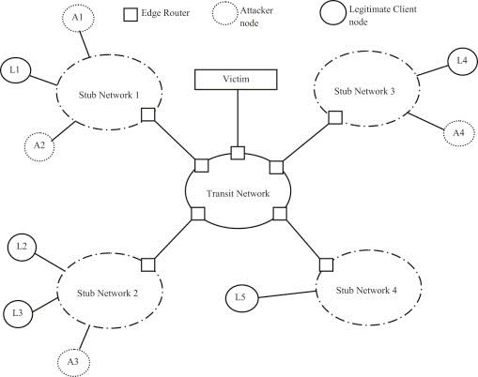
Flash Crowd
A flash event is a large increase in traffic to a particular Web site causing a dramatic growth in server load and putting severe and network links under "pressure",leading to the server, which results in considerable increase in packet loss and congestion
5/20

Slide 6
Related work
Xi Qin et. al. gives the approach to detect DDoS attacks in high speed networks, using K means clustering algorithm to model the incoming patterns, in this period different clusters with center C and radius R are formed, the main problem is the model requirement to frequent training.
Shui et. al. uses the Sibson distance between two incoming traffic and if this distance is more than a threshold then the incoming traffic is marked as attack traffic or flash crowd. But it cannot detect DDoS attack and flash crowd at the same time.
6/20

Slide 7
Assumptions
Different Scenarios |  |  | Simulated Environment
Packet Generated | Number of Groups | Number of hosts
409 | 5 | 50 | Normal Operation
809 | 7 | 15 | DDoS Attack
809 | 47 | 40 | Flash Crowd
IP addresses – it’s not specified how IP’s are distributed in the different operations.
Center of group – not specified, if the received IP was not added to any existing group, new group has created with the new IP.
Distance –35, after calculating the mean distance for regular traffic.
Threshold for entropy – was not declared.
Average Number of messages – each host was calculated by (packets generated/number of hosts) that was presented in simulation results.
7/20

Slide 8
The algorithm
8/20

Slide 9
Grouping packets
Each packet is placed in a specific group if its distance from the centroid of that respective group is less than some distance value. If no such group is present then a new group is formed to store that packet.
9/20

Slide 10
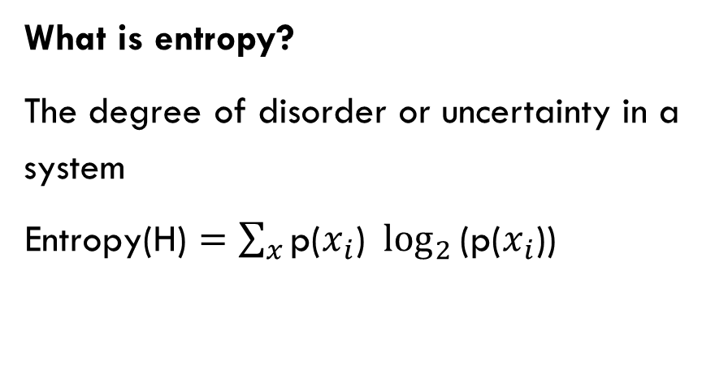
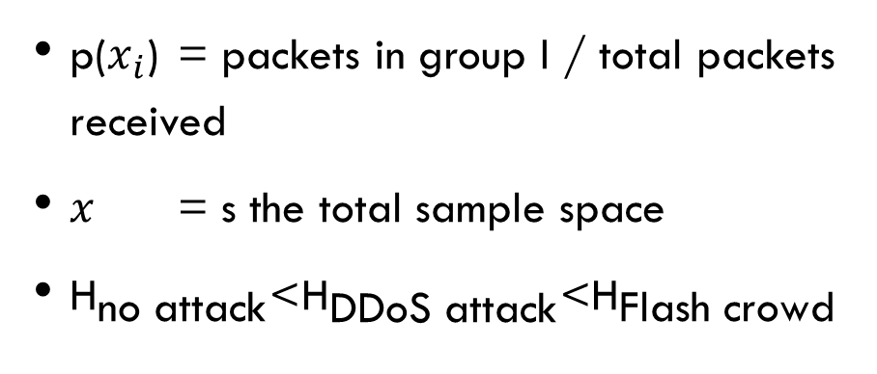
Entropy calculation
What is entropy?
The degree of disorder or uncertainty in a system
$\text{Entropy}\text{(}\text{H}\text{)}=\sum_{x}{\text{p}\text{(}x_{i}\text{) }\log_{2}{\text{(}\text{p}\text{(}x_{i}\text{))}}}$
$\text{p}\text{(}x_{i}\text{) }$ = packets in group I / total packets received
$x$ = s the total sample space
${\text{H}}_{\text{no} \text{attack}}\text{<}{\text{H}}_{\text{DDoS} \text{attack}}\text{<}{\text{H}}_{\text{Flash} \text{crowd}}$
10/20

Slide 11
Entropy calculation
The entropy of each traffic is different
DDoS attack – attacker uses IP spoofing so source IP addresses are random in nature.
Normal - source IP addresses are not very scattered, so the entropy is less then DDoS attack entropy.
Flash crowd attack - source IP addresses are completely random so its entropy is high as compare to the entropy of other two scenarios
$${\text{H}}_{\text{no} \text{attack}}\text{<}{\text{H}}_{\text{DDoS} \text{attack}}\text{<}{\text{H}}_{\text{Flash} \text{crowd}}$$
11/20

Slide 12
Compare entropy to threshold
If the entropy is less then the threshold then the traffic is normal, and new score is calculated and stored, as defined in the next slide.
The threshold was not predefined so we assumed it by the results of the entropy we achieved.
12/20

Slide 13
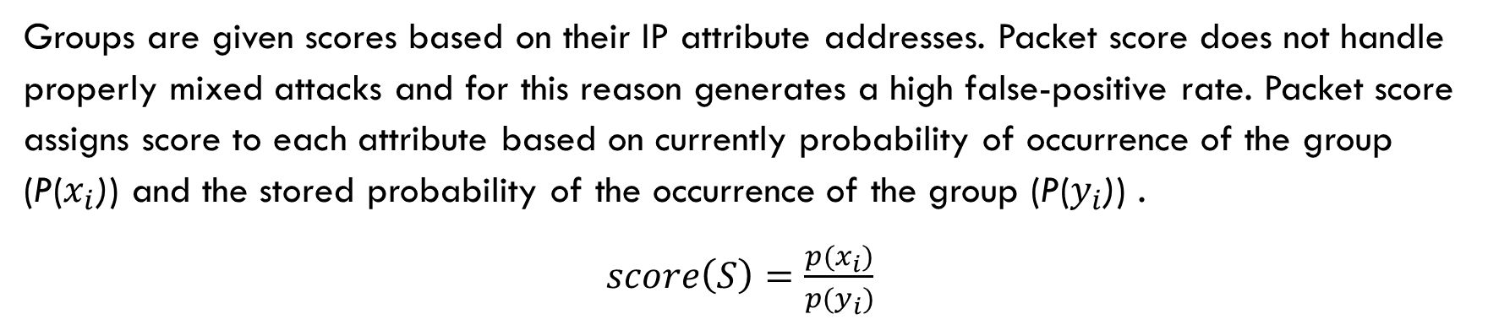
Score calculation
Groups are given scores based on their IP attribute addresses. Packet score does not handle properly mixed attacks and for this reason generates a high false-positive rate. Packet score assigns score to each attribute based on currently probability of occurrence of the group (P($x_{i}$)) and the stored probability of the occurrence of the group (P($y_{i}$)) .
$score\left(S\right)=\frac{p(x_{i})}{p(y_{i})}$
13/20

Slide 14

Complexity – time & space
Time complexity of O(n) and space complexity of O(g), where n and g are the numbers of packets received and the number of groups formed during measuring time interval.
14/20

Slide 15
Results
DDoS attack – group division
15/20

Slide 16
Results
Flash Crowd attack- group division
16/20

Slide 17
Results - entropy
17/20

Slide 18
Results
This is the article Entropy plot, we think that they took the mean value for entropy, and after 30 seconds the entropy derrises to zero cause there are no new messages.
18/20

Slide 19
Results
Score value– different group division
19/20

Slide 20

Thank you for listening
20/20

